Slide 1
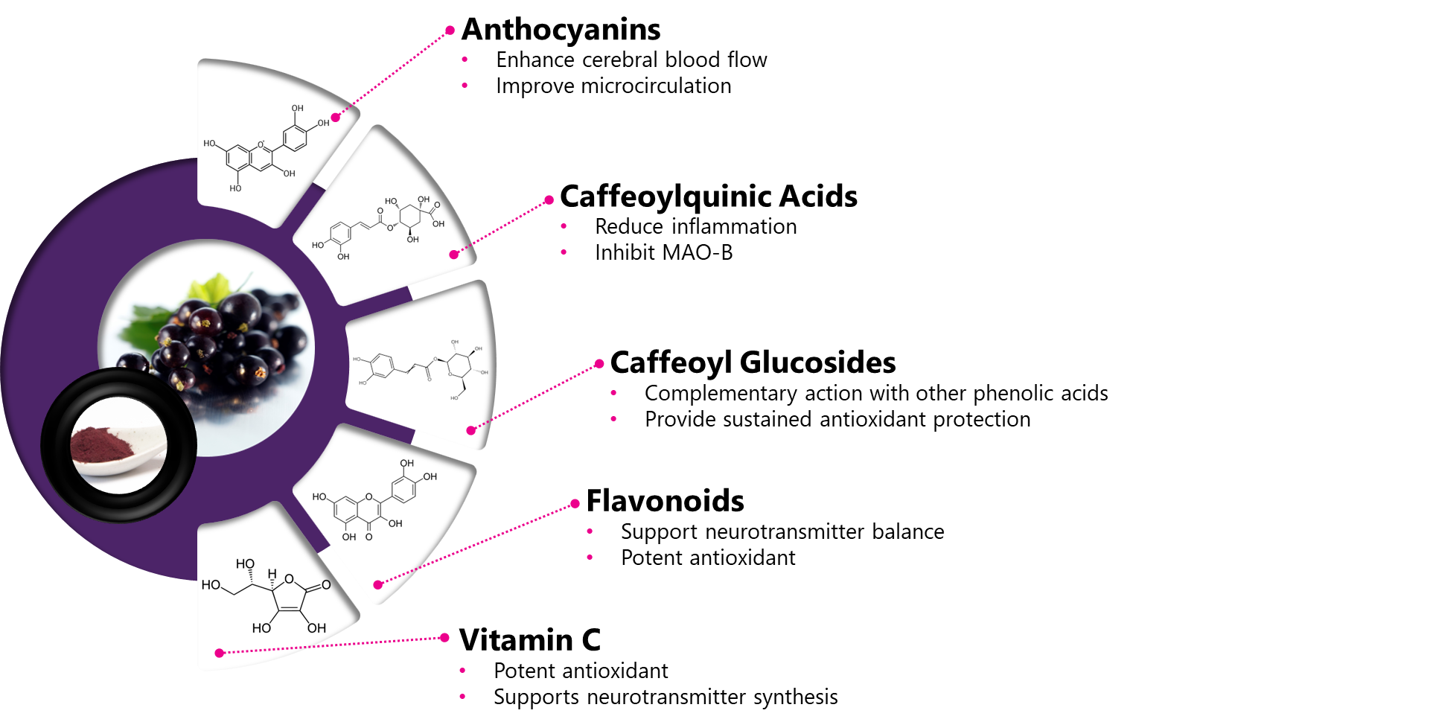

Functional Food
Notes:
What is Braincurrant®
Braincurrant is a premium, whole-fruit New Zealand blackcurrant powder developed by Anagenix to support cognitive performance and long-term brain health.

Slide 2

Braincurrant®: Comprehensive Cognitive Support
This unique braincurrant powder delivers potent anthocyanins and polyphenols.
Its vibrant color and tangy flavor enhance functional beverages, gummies, and lozenges.
pH
3.0
Solubility
TBC
Shelf Life
36 months
Bulk Density
0.61 g/mL
Standardized Bioactive
>3g Total Polyphenol Content
Sugar %
Low GI Index
Water Activity
<0.2
Format
Powder
Dosage
300mg
Suitable
Brain support – mood, memory and focus
Notes:
Braincurrant offers a full nutritional panel, it is high in vitamin a, vitamin e, zinc, and dietary folate.
It is standardized to 650mg total anthocyanins.
The spider chart shows its organoleptic profile, its primarily berry flavour, but also has excellent color making it ideal for***both taste and color in a formulation.****
It is available in ***two formats, concentrate for liquids and powder for smoothie mixes, yogurts, etc. **
It has a low GI impact and low water activity.
The powder is mostly soluble but some fibre will settle in a drink but it is pleasant to consume.

Slide 3
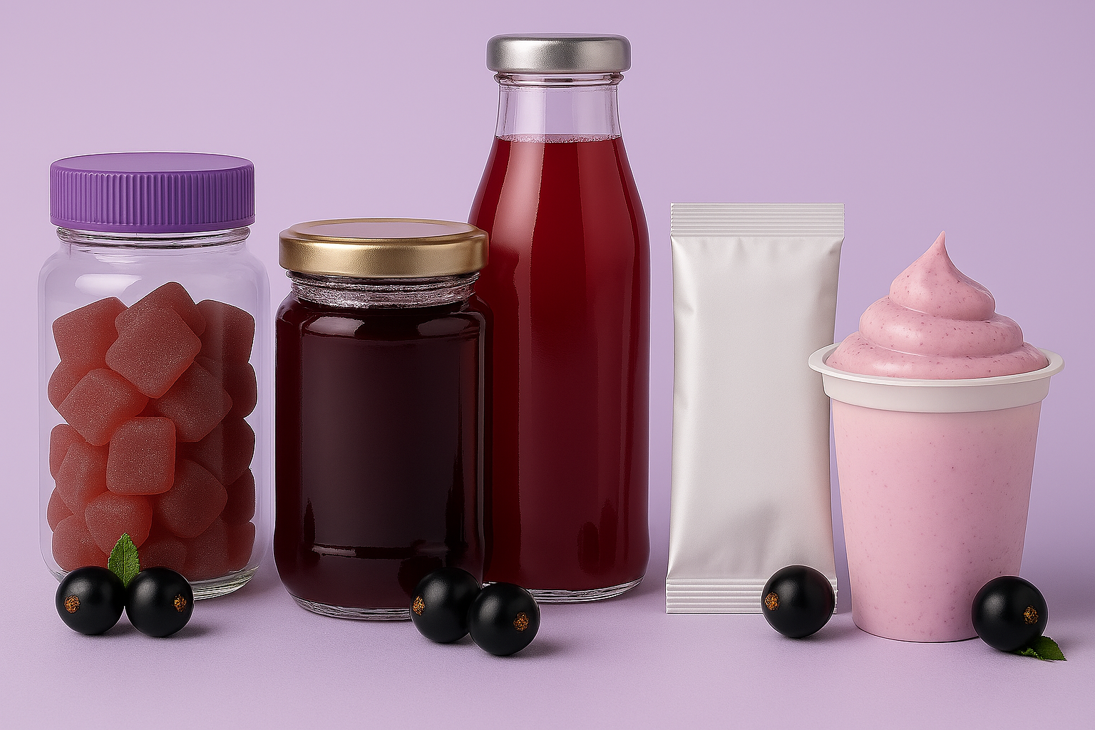
Product concepts and applications
Gummies
Honey infusions
Beverages
Sachet (powder)
Yoghurt
Mood balance
Mental clarity
Energy & Focus

Slide 4
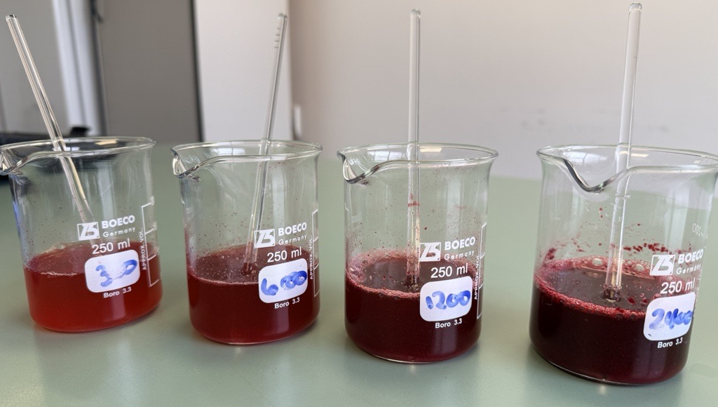
Braincurrant®: Shot Formulations
As a whole fruit powder, Braincurrant is soluble and does contain a small amount fiber, which has important health benefits and contributes to the functionality of the ingredient. Braincurrant adds 100% natural color and taste to your product. Suitable for a variety of beverage formats such as shots, drinks, powdered sachets, pouches, and more!
300mg
Minimal tart flavour and light pink colour impact
Functional benefits provided
No particles visible
600mg
Lightly fruity and tart flavour, strong pink colour impact
Some small particles present
1200mg
Flavour similar to Ribena, very tart, dark red colour impact
Slight astringency
2400mg
The most yummy of all the shots, tastes like a delicious berry beverage, purple colour impact
Very astringent, could do with some sweetener

Slide 5
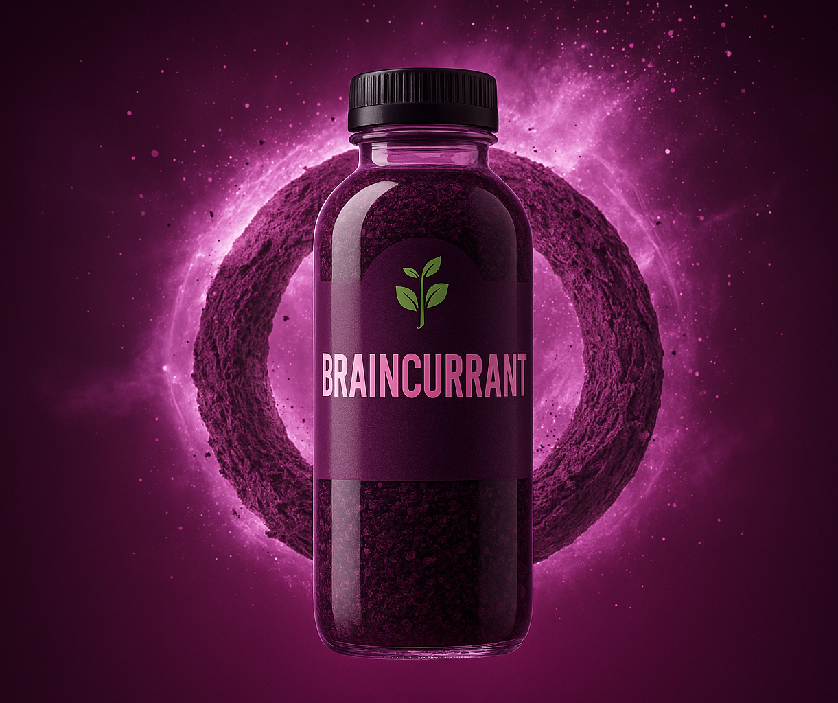
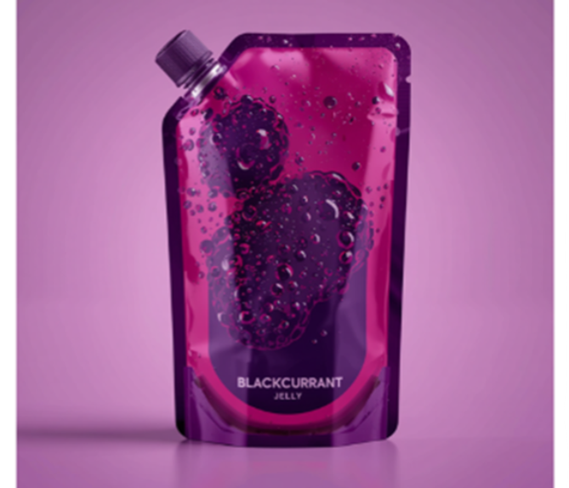
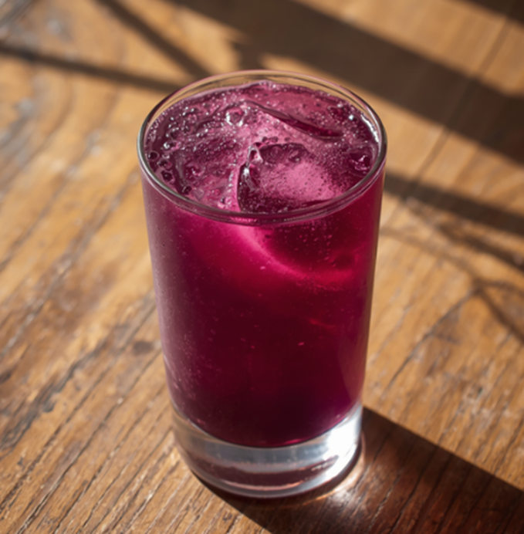
Braincurrant®: Recharge Shot
A concentrated blackcurrant brain shot designed to rapidly recharge mental energy, focus, and clarity when you need it most.
Supports quick mental sharpness and clear thinking
Helps reduce feelings of mental fatigue during busy days
Delivers blackcurrant bioactives in a fast, convenient shot format

Slide 6
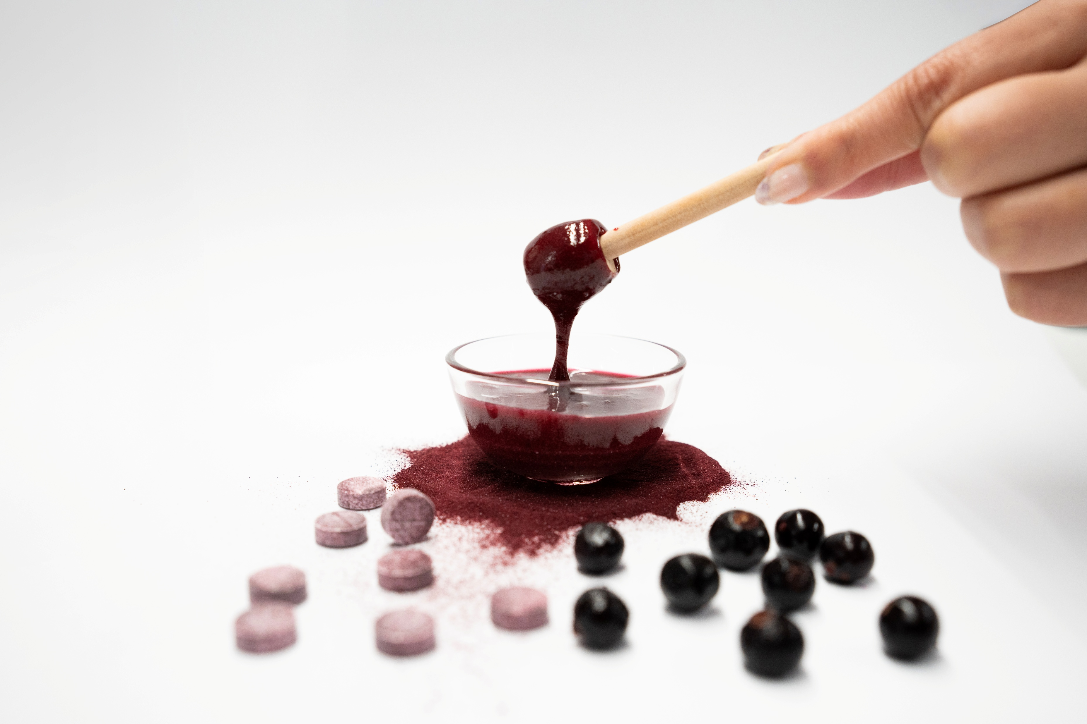
Braincurrant® – Manuka Honey Blend
A rich, tangy-sweet honey layered with deep berry notes — beautifully paired with artisan cheeses, stirred into yoghurt, or added to tea and smoothies. Pure, raw, and packed with natural goodness
Braincurrant:
Bioactives that support brain health
Rich in anthocyanins — powerful antioxidants that help fight neuroinflammation
Manuka Honey
Contains MGO (methylglyoxal) — its signature antibacterial compound
Supports gut health and digestion
Anti-inflammatory
Rich in antioxidants
Combined — a powerful pairing: Together, blackcurrant and manuka honey deliver a double hit of antioxidants, and anti-inflammatory benefits — making this more than just a delicious honey, but a functional everyday wellness food.

Slide 7
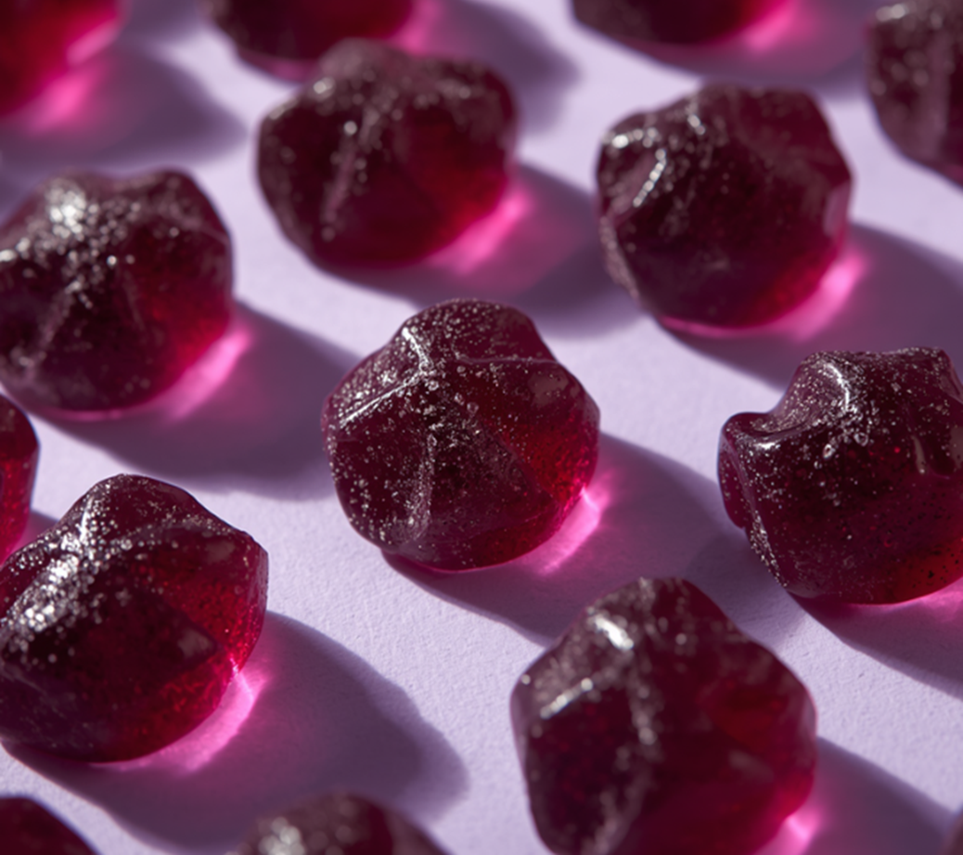
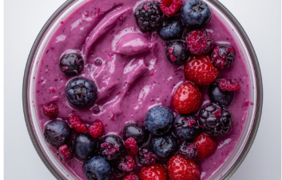
Mood Balance Braincurrant® Gummies
A delicious daily gummy that supports mood balance and emotional resilience, combining New Zealand blackcurrant polyphenols with mood‑supportive nutrients.
Maintain a balanced, positive mood
Emotional wellbeing
Balance mood
Brain-Boost Smoothie Bowl
Helps you start the day focused and ready to think. A polyphenol-rich breakfast solution featuring Braincurrant
Supports clear thinking and focus
Helps protect brain cells from daily stress
Fuels a brain-friendly start with yogurt and blackcurrant

