Slide 1



turbocharge protein digestion

Slide 2
Protein is booming
Plant protein is driving the next wave of growth
$100B+
Market opportunity
Beyond powders: bars, beverages, gummies & functional foods
Plant protein: one of the fastest-growing segments
Notes:
The protein market is booming
The global protein ingredients market is worth over USD 60 billion and is projected to exceed USD 100 billion within the next decade.
Protein has moved beyond sports powders into mainstream functional foods, beverages, snacks and supplements
Plant protein is one of the fastest-growing segments
https://www.fortunebusinessinsights.com/protein-ingredients-market-115863?
https://www.zionmarketresearch.com/report/protein-ingredients-market?

Slide 3
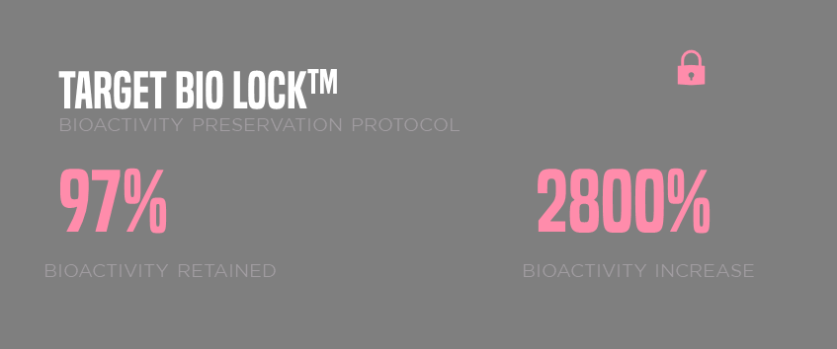
Nature built this.
We concentrated it.
212%
Notes:
Unique manufacturing process- Target BioLock. Not just freeze dried kiwifruit. Unique, maybe include SEM images
ACTINIZYME is freeze-dried whole green kiwifruit powder, standardised to a minimum of 100,000 U/g actinidin activity.
Not sure if you want this but:
If actinidin is go great.. Why has it taken so long for someone to do this?
Actinidin is not a tropical commodity enzyme. Papain comes from papaya. Bromelain comes from pineapple. Both grow at scale across tropical Asia with established extraction industries.
Kiwifruit grows in New Zealand. Building the supply chain, the freeze-drying capability, and the standardisation methodology from scratch took fifteen years. That is why only Anagenix makes this.
Nature built this. We concentrated it.

Slide 4
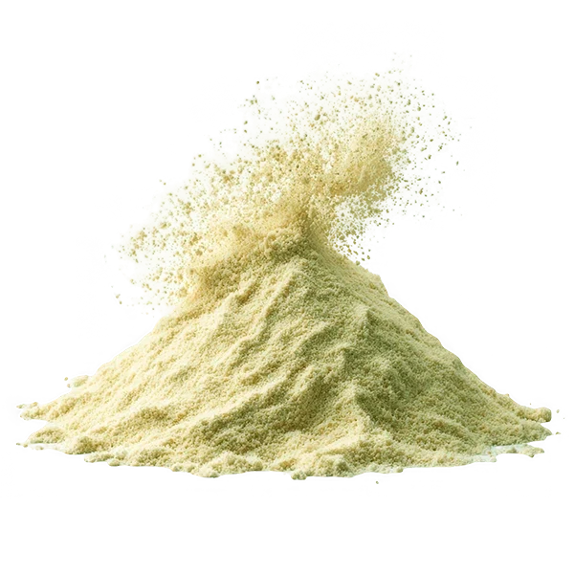
Meet
Freeze dried whole green kiwifruit
Native fruit matrix
Not an extract
>100k
U/G actinidin activity
Notes:
Unique manufacturing process- Target BioLock. Not just freeze dried kiwifruit. Unique, maybe include SEM images
ACTINIZYME is freeze-dried whole green kiwifruit powder, standardised to a minimum of 100,000 U/g actinidin activity.
Not sure if you want this but:
If actinidin is go great.. Why has it taken so long for someone to do this?
Actinidin is not a tropical commodity enzyme. Papain comes from papaya. Bromelain comes from pineapple. Both grow at scale across tropical Asia with established extraction industries.
Kiwifruit grows in New Zealand. Building the supply chain, the freeze-drying capability, and the standardisation methodology from scratch took fifteen years. That is why only Anagenix makes this.
Nature built this. We concentrated it.

Slide 5


Digestion is
a problem
for
Plant proteins
Absorption
GAP
Plant proteins offer 75-80% digestibility compared to animal sources _{[1]}.
Notes:
Protein is a huge conversation in sports nutrition. But I would argue that protein absorption is a far bigger one
The conversation has always been about quantity. How many grams. How many servings, etc
But the conversation that matters is different. It is about how much of that protein actually gets absorbed.
For whey, the answer is nearly all of it (see DIAAS next slide).
Whey is already at ceiling. Margin and innovation live in the gap.
Plant protein has the biggest performance gap in the category — and we think Actinizyme is uniquely positioned to close it.**

Slide 6
DIAAS: how well a protein provides and delivers the essential amino acids your body can digest and absorb
A consumer buying
25g of pea protein is
NOT absorbing 25g of usable
amino acids
WHEY PROTEIN ISOLATE
SOY PROTEIN ISOLATE
PEA PROTEIN CONCENTRATE
RICE PROTEIN CONCENTRATE
125
88-98
74
59
FAO >3y reference pattern [2]
Notes:
Two products can have identical labels. But..
Different absorption profiles. Different outcomes for the consumer.
DIAAS (Digestible Indispensable Amino Acid Score) is the "gold standard" for measuring protein quality.
It scores two things: how much the body actually absorbs, and which amino acids it delivers relative to what humans need. Whey sits at the top. Soy is the closest plant protein. Then a big drop-off across pea, rice, hemp.
When a customer reads "25g protein" on a plant protein tub, they're not getting 25g of usable amino acids. Amino acids build muscle, proteins don't, until they're broken down.
Comes up to a 20–30% delivery gap for most plant proteins.
Comprehensive overview of the quality of plant‐ And animal‐sourced proteins based on the digestible indispensable amino acid score - Herreman - 2020 - Food Science & Nutrition - Wiley Online Library
Protein Digestibility-Corrected Amino Acid Scores and Digestible Indispensable Amino Acid Scores Differentially Describe Protein Quality in Growing Male Rats1–3 - The Journal of Nutrition

Slide 7
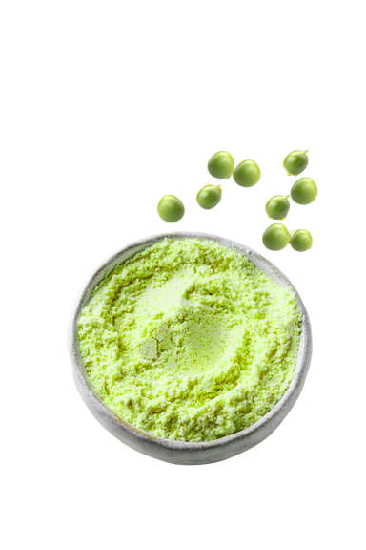
TWO
barriers to plant digestion
Anti-nutrition factors
Bonds are hard to cut
Notes:
Why are plant proteins hard to digest? Two reasons plant proteins underperform:
1) Anti-nutritional factors. Legumes are rich in trypsin inhibitors, compounds that block the body's main intestinal protease. Less digestion upstream → more fermentation downstream → bloating.
2) Tight structure. Plant proteins are globular and inaccessible. Your body's own enzymes can't get at the cleavage sites.
These two barriers work together. One neutralises your digestive enzymes before they act. The other stops them finding a way in.
Same gram of protein in. Less amino acid out.

Slide 8

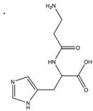
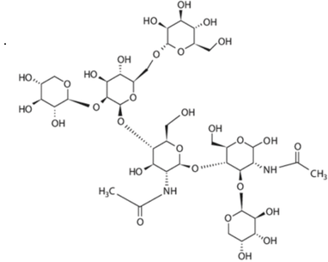
LEGACY solutions HAVE TRADEOFFS
Both are broad-spectrum proteases
They digest everything
…
including digestive enzymes themselves
30
MINS
is all it takes for papaya and pineapple extracts to degrade gastric lipase _{[4]}
PAPAIN DIES IN STOMACH
Needs expensive enteric coating to survive gastric transit _{[3]}.
BROMELAIN AFFECTS FAT DIGESTION
Degrades gastric lipase, potentially affecting fat‑soluble vitamins (A, D, E, K) absorption _{[4]}
¹[MARTIN ET AL. 2017]
Notes:
Not sustainable - extracts
The market's answer: papain and bromelain, but they’re legacy solutions that don’t quite hit all the checkboxes
Papain loses activity irreversibly below pH 3. Without enteric coating, most activity is gone before it reaches the small intestine.
Bromelain survives the stomach better, but at a cost: it degrades gastric lipase, the enzyme responsible for 10-30% of fat digestion and absorption of fat-soluble vitamins A, D, E, and K. [Martin et al. 2017]
So the trade-off has been: pay for enteric coating, or risk interfering with fat digestion.
Both arrive as solvent-extracted isolates. Neither is a whole-food ingredient.

Slide 9
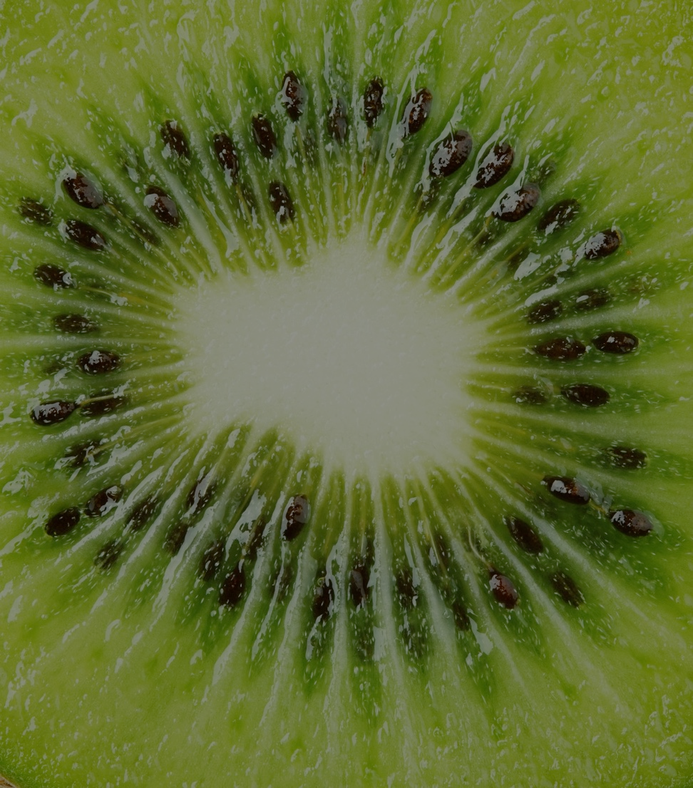
the answer was in a kiwifruit
Actinidin is A cysteine protease that addresses
structural barriers to plant protein digestion
01 BYPASSES PLANT’S DEFENCES
02 CUTS TOUGH PLANT PROTEINS
Notes:
The answer was in a kiwifruit. It has been there the whole time. Green kiwifruit contains a natural protease enzyme. Researchers have known about it for decades. Nobody concentrated it at scale into a functional ingredient until Anagenix did.
That enzyme is actinidin, a cysteine protease. Around 40% of all soluble protein in Hayward cultivars is this one enzyme, it's highly enriched by nature, no concentration step required.
Structurally different from the human body’s enzymes, and that structural difference is what matters.
Remember the two barriers to plant protein digestion? Actinidin clears both:
1) It's a cysteine protease, so it bypasses the trypsin inhibitor block entirely. Different enzyme family, different mechanism.
Barrier one, gone.
2) It cleaves the tough bonds plant proteins hide behind — specifically proline-adjacent bonds, which most proteases struggle with because of the rigid five-ring structure. Actinidin is so good at this it even cleaves gluten, which is notoriously hard to break down.
Barrier two, gone
So that's the mechanism. Now — does it actually outperform the legacy options?

Slide 10
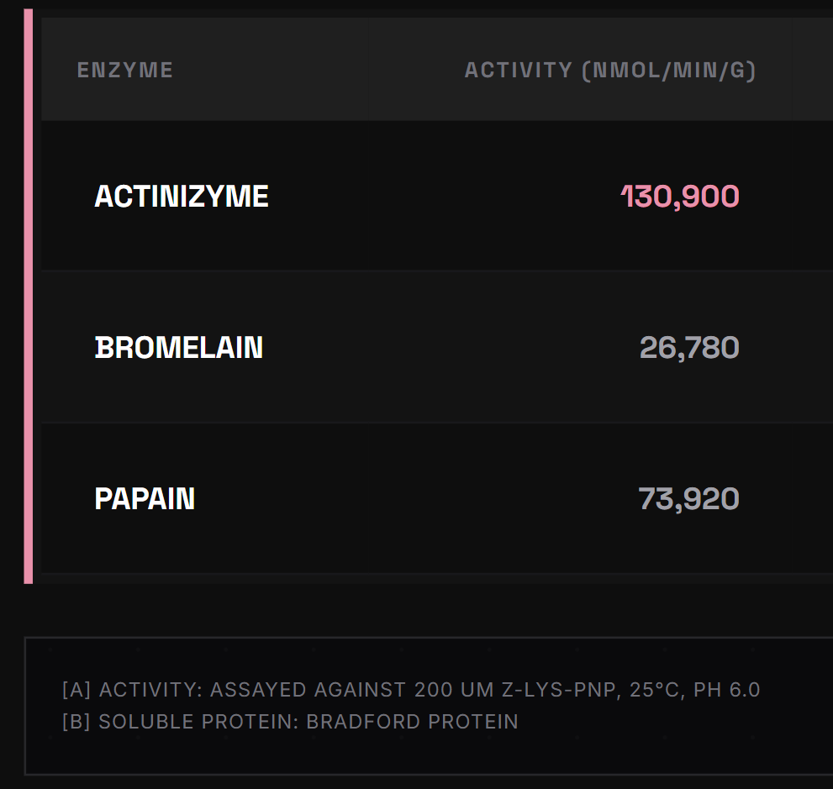

ACTINIZYME HAS UP TO ~X5 performance
[A]
~ 5× more active than bromelain
~2× more active than papain
Anagenix Internal Data
¹[MARTIN ET AL. 2017]
Notes:
The market's answer: papain and bromelain, but they’re legacy solutions that don’t quite hit all the checkboxes
Papain loses activity irreversibly below pH 3. Without enteric coating, most activity is gone before it reaches the small intestine.
Bromelain survives the stomach better, but at a cost: it degrades gastric lipase, the enzyme responsible for 10-30% of fat digestion and absorption of fat-soluble vitamins A, D, E, and K. [Martin et al. 2017]
Both arrive as solvent-extracted isolates. Neither is a whole-food ingredient.

Slide 11
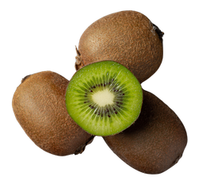
Benefits of
Using
Actinizyme
NO ENTERIC COATING NEEDED
Works with pepsin,
not redundantly _{[5]}
STABLE FROM
pH 3-10 _{[5]}
Full digestive tract _{[6]}
4H
No extractions. No solvents. Clean label
BIOACTIVITY
GASTRIC
2 HR
INTESTINAL
2 HR
Notes:
No extraction step. No solvents. The enzyme arrives in its native fruit matrix, with dietary fibre, vitamin C, and polyphenols intact. Label declaration: freeze-dried green kiwifruit powder.
How it works where others don't reach.
Active pH 3-10. Full gastric and intestinal coverage. No enteric coating needed.
Cleaves proline-adjacent bonds, the bonds that make plant proteins hardest to digest.
Gliadin (a particularly hard to digest gluten protein) hydrolysis rate was approximately 2x that of papain and bromelain. [Jayawardana et al. 2021, in vitro
Works alongside pepsin, not redundantly. Different cleavage sites. Additive effect on protein breakdown.
Survives 4 hours of simulated GI digestion in active form. [Grozdanovic et al. 2014, in vitro]
It does not just start the job. It stays for the whole job.

Slide 12
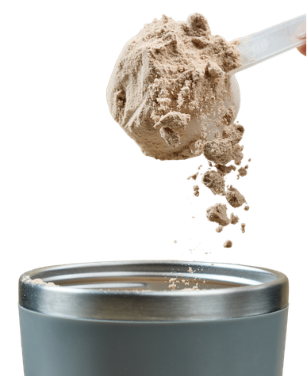
3 reasons to add
to your protein formula
1. Performance
2. Digestion SYNERGY
3. Comfort

Slide 13
ACCELERATING Amino ACID RELEASE
Increase of
EAA, BCAA
& leucine
as early as
40 mins
post-meal _{[7]}
*
*
*
*
*
*
* Statistically significant (p < 0.01)
PERFORMANCE
1
Notes:
Park et al. 2021: kiwifruit co-ingestion produced statistically significant earlier peaks in plasma EAA, BCAA, and leucine. p < 0.01, within 40 minutes of ingestion, across all three markers. This is human data.
Speed matters because muscle protein synthesis is triggered by crossing the leucine threshold in the blood. A faster peak means a sharper anabolic signal. The same total amino acids, arriving later, produce a weaker response. For plant proteins, already lower in leucine, slow delivery compounds the problem: peak plasma leucine may never reach the threshold needed to maximally trigger muscle protein synthesis. Speed is why whey dominates sports nutrition.
Actinidin has the enzymatic tools to move plant protein into that faster-digesting category, so it’s a vast opportunity!
Note: We haven't demonstrated this directly in a clinical trial, so the language is deliberate: "has the tools." The mechanism is there, and Park 2021 shows the effect in humans.
Control was gold kiwifruit and the other one was green kiwifruit, human studuy

Slide 14
WORKS
ON TOP
OF body's own enzymes
Gastric phase (2-60 min) Intestinal phase (70-180 min)
IN PIGS
27% Faster Gastric Emptying _{[8]}
44% More nitrogen, EARLIER _{[9]}
Charts derived from Kaur et al. (2022) _{[5]}
DIGESTION SYNERGY
2
Notes:
500% increase for PPI
Actinidin is a 2-in-1 protease. It accelerates protein breakdown in the stomach and stays active in the small intestine, where most amino acid absorption happens. Most proteases cover one site. Actinidin covers both.
These three charts come from a three-stage in vitro digestion model using real human digestive enzyme concentrations.:
The white line is digestive enzymes alone.
The pink line is kiwifruit plus digestive enzymes.
The gap between them is actinidin's contribution on top of what the body already does.
The gastric phase is where the story starts. Look at the almond panel. At two minutes, digestive enzymes alone release 1.6% amino nitrogen. With Actinizyme: 6.4%. Four times more breakdown in the first two minutes. The same direction holds for pea protein and soy, plant proteins with tightly-folded structures where the body's own enzymes struggle most.
Contribution is front-loaded, concentrated in the early gastric phase, where speed matters most for what comes next.
Some might say. This is just an in vitro test tube study. But there are 2 separate pig studies, Montoya 2014 and 2018, pig in vivo.
Gastric emptying 27% faster. 44% more digested nitrogen reaching the small intestine at five hours. The pig GI tract is the accepted benchmark for human digestive research. Same direction. Same mechanism. Confirmed across model types.
And now, look at second site. Look at the grey shaded region, that's the intestinal phase, 70 to 180 minutes. Actinizyme is still above digestive enzymes alone. The gap continues. That's actinidin still working, in the intestine, on top of what the body does there too
Remember, it’s not often you get an enzyme that’s active across both stomach and intestine. Actinidin is stable across the full digestive range. Two sites. One ingredient. That is the 2-in-1.
Ref:
8. Montoya, C. A. et al. Actinidin from kiwifruit ( Actinidia deliciosa cv. Hayward) increases the digestion and rate of gastric emptying of meat proteins in the growing pig. Br. J. Nutr. 111, 957–967 (2014).
Table 3 T1/2 with actinidin: 134, without: 184. Difference is (184-134)/134*100 = 27.2%
9.Montoya, C. A., Cabrera, D. L., Zou, M., Boland, M. J. & Moughan, P. J. ’The Rate at Which Digested Protein Enters the Small Intestine Modulates the Rate of Amino Acid Digestibility throughout the Small Intestine of Growing Pigs. J. Nutr. 148, 1743–1750 (2018).
The rate of digested nitrogen entering the SI was higher (P < 0.001) with actinidin (e.g., >44% at 5 h postprandially)

Slide 15
REDUCES
BLOATING
CLINICAL TRIAL
44% REDUCTION IN BLOATING AUC SCORE _{[10]}
Randomised Cross-over Trial
WITH ACTINIDIN
CONTROL
p < 0.05 Statistically significant reduction
ANAGENIX CONSUMER DATA
REAL WORLD FEEDBACK AFTER 2 weeks
UK Audience | Protein: Whey soy, pea, rice, hemp
-37%
BLOATING/GAS
-34%
ABDOMINAL PAIN
84
150
-29% REFLUX
COMFORT
3
Notes:
Actinidin works on both origins of bloating, which is why we see the effect in a controlled trial and again in real-world consumer use.
This matters commercially because bloating is what kills retention for plant protein brands. Customers buy the product, feel uncomfortable, and stop repurchasing. Ingredient selection is where that gets fixed.
Suggestion: Start with the mechanism, because it's what makes actinidin unusual.
Bloating comes from two places:
Gastric pressure in the first 30 to 90 minutes after a meal, when a slow-digesting protein mass keeps the stomach distended.
And colonic fermentation hours later, when protein that escaped the small intestine gets fermented by bacteria into gas. Most proteases denature in stomach acid, so they can only touch the first window. Actinidin survives the full four hours of upper GI transit, which is what lets it work on both.
Pre-clinical evidence from Montoya 2018 supports this: absorption gets front-loaded in the proximal small intestine, leaving less protein to reach the colon.
Then the clinical proof.
Wallace 2017 is a randomised human crossover trial, which is our strongest evidence tier. Postprandial bloating AUC near-halved over five hours. p=0.005. Not 0.05, 0.005. Real-world confirmation!
The Anagenix consumer data trends in the same directions. It’s not a clinical trial, it’s 21 UK consumers, two weeks, using real products across whey, soy, pea, rice, and hemp.
37% reduction in bloating and gas, 34% in abdominal pain, 29% in reflux. Directional only, but it points the same way as Wallace, across a different study design and a different time horizon.
Controlled trial and consumer use, same trend direction in reducing bloating

Slide 16
3 key positioning platforms
1. Muscle Performance
2. Healthy Ageing
3. Women’s Wellness
Notes:
So hopefully I've convinced you that protein digestion matters, and that Actinizyme offers a unique solution through actinidin.
But ultimately, customers don't buy enzymes — they buy consumer benefits.
So where does Actinizyme fit in the market?
We see three key positioning opportunities.

Slide 17

1. Muscle Performance
Faster protein digestion.
Faster amino acid delivery.
Supporting muscle protein synthesis and recovery
Target applications: Sports nutrition, active lifestyle, exercise recovery, protein powders, RTDs
Notes:
1. Muscle Performance & Active Nutrition
Accelerates the appearance of plasma EAAs, BCAAs and leucine following protein consumption.
Supports rapid amino acid availability, a key factor influencing muscle protein synthesis.
Particularly relevant for plant protein products, where digestion can be slower than animal proteins.
Helps improve protein utilisation while reducing digestive discomfort associated with high-protein diets.
Target applications: Sports nutrition, active lifestyle, recovery, protein powders, RTDs.
Park et al. 2021: Green kiwifruit co-ingestion produced statistically significant earlier peaks in plasma EAA, BCAA, and leucine. p < 0.01, within 40 minutes of ingestion, across all three markers. This is human data. Control was gold kiwifruit.
Speed matters because muscle protein synthesis is triggered by crossing the leucine threshold in the blood. A faster peak means a sharper anabolic signal. The same total amino acids, arriving later, produce a weaker response. For plant proteins, already lower in leucine, slow delivery compounds the problem: peak plasma leucine may never reach the threshold needed to maximally trigger muscle protein synthesis. Speed is why whey dominates sports nutrition.
Actinidin has the enzymatic tools to move plant protein into that faster-digesting category, so it’s a vast opportunity!
Note: We haven't demonstrated this directly in a clinical trial, so the language is deliberate: "has the tools." The mechanism is there, and Park 2021 shows the effect in humans.
Two things to have ready if someone pushes back. First, peak leucine concentration was similar between groups in Park 2021. The effect is on rate of arrival, not peak height. That's still meaningful for the anabolic window, but don't overstate it. Second, Park 2021 used beef, which is already 90-97% digestible. The kinetics effect didn't translate to a measurable MPS difference in that study, likely because the ceiling was already high. For proteins where both speed and total hydrolysis are genuinely limited, the opportunity is larger. That's what the closing line is saying.

Slide 18

2. Healthy ageing
Optimising protein nutrition for healthy ageing
Supporting muscle preservation as we age
Target applications: Healthy ageing, mobility, strength, senior nutrition
Notes:
2. Healthy Ageing & Muscle Preservation
Ageing is associated with anabolic resistance, meaning older adults require more effective protein delivery to maintain muscle mass.
Actinidin has been shown to accelerate amino acid appearance following protein consumption.
Improved protein digestion may help support healthy ageing strategies focused on muscle maintenance and strength.
Reduced digestive discomfort can help improve adherence to higher-protein diets often recommended for older adults.
Target applications: Healthy ageing, mobility, strength, senior nutrition, medical nutrition.

Slide 19

3. Women's Wellness
Clean-label protein support for everyday wellness
Designed for comfort, confidence and active living
Target applications: Women's health, meal replacements, lifestyle nutrition, weight management, wellness shakes
Notes:
3. Comfortable protein for everyday health.
Many women seek protein products that support muscle tone, healthy ageing and weight management without causing bloating.
Clinically shown to reduce upper GI discomfort and feelings of fullness after protein-rich meals.
Natural kiwifruit origin aligns with clean-label and wellness-focused product positioning.
Enables brands to deliver a more comfortable protein experience without changing protein content, flavour or formulation.
Target applications: Women's health, meal replacements, lifestyle nutrition, weight management, wellness shakes.
Actinidin works on both origins of bloating, which is why we see the effect in a controlled trial and again in real-world consumer use.
This matters commercially because bloating is what kills retention for plant protein brands.
Customers buy the product, feel uncomfortable, and stop repurchasing.
Ingredient selection is where that gets fixed.
Suggestion: Start with the mechanism, because it's what makes actinidin unusual.
Bloating comes from two places:
Gastric pressure in the first 30 to 90 minutes after a meal, when a slow-digesting protein mass keeps the stomach distended.
And colonic fermentation hours later, when protein that escaped the small intestine gets fermented by bacteria into gas. Most proteases denature in stomach acid, so they can only touch the first window. Actinidin survives the full four hours of upper GI transit, which is what lets it work on both.
Most proteases denature in stomach acid and can only influence the first stage. Actinidin remains active throughout upper gastrointestinal transit, allowing it to support protein digestion across both phases. Pre-clinical evidence from Montoya 2018 supports this: absorption gets front-loaded in the proximal small intestine, leaving less protein to reach the colon.
Then the clinical proof. Wallace 2017 is a randomised human crossover trial, which is our strongest evidence tier. Postprandial bloating AUC near-halved over five hours. p=0.005. Not 0.05, 0.005. Real-world confirmation!
The same trend was observed in Anagenix consumer data. In 21 UK consumers using whey, soy, pea, rice and hemp protein products for two weeks, participants reported: 37% reduction in bloating and gas, 34% in abdominal pain, 29% in reflux. Directional only, but it points the same way as Wallace, across a different study design and a different time horizon.
Controlled trial and consumer use, same trend direction in reducing bloating

Slide 20
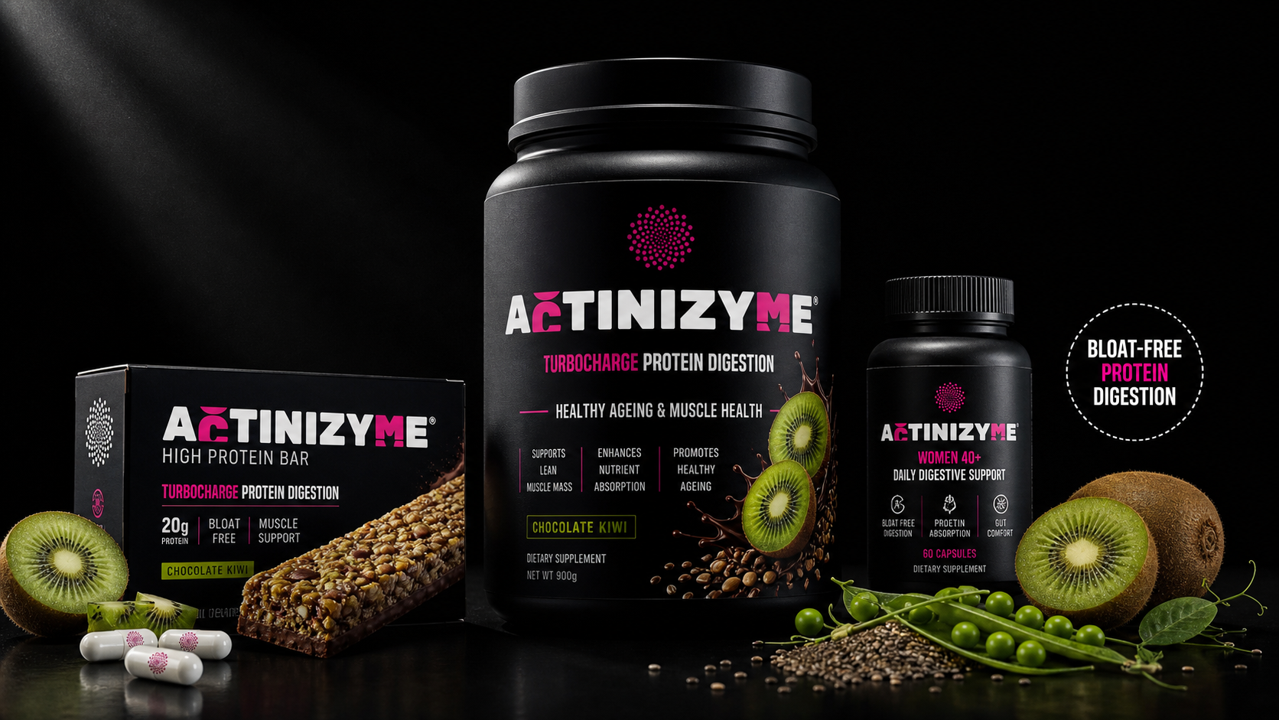
NPD and product Concepts

Slide 21

Low dose
200 mg/ 30 g protein
(Standard serve of protein isolates)
  Undetectable flavour
  Undetectable texture
  Enhanced protein powder
  Results consumers can feel

Slide 22
Helping consumers get more from the protein they already consume
Notes:
So to wrap up, protein remains one of the fastest-growing categories in nutrition.
As consumers look for better performance from both plant and animal proteins, improving protein utilisation is becoming an increasingly important area of innovation.
Actinizyme offers a natural, science-backed solution built around the unique protease actinidin.

Slide 23


CLEAN LABELS USUALLY COST YOU PERFORMANCE NOT THIS TIME
Notes:
Clean label usually costs you performance. Not this time.
The old trade-off: whole-food ingredients tick the clean-label box. Isolated enzyme extracts deliver clinical performance. Formulators have always had to choose between the two.
Actinizyme breaks that trade-off. Whole-food provenance. Clean-label declaration. And on the measures that count — gastric-pH activity, proline cleavage, and full GI survival — it matches or outperforms the isolated alternatives.
At the booth:
Try the formats — jelly sticks, gummies, chewables, shots.
Functional food factsheets available: bioactivity at bar, gummy, and beverage processing temperatures.
MOQ and technical documentation on request.

Slide 24
References
1.Opazo-Navarrete, M. et al. Comprehensive Review of Plant Protein Digestibility: Challenges, Assessment Methods, and Improvement Strategies. Appl. Sci. 15, (2025).
2.Herreman, L., Nommensen, P., Pennings, B. & Laus, M. C. Comprehensive overview of the quality of plant- And animal-sourced proteins based on the digestible indispensable amino acid score. Food Sci. Nutr. 8, 5379–5391 (2020).
3. Sharma, M., Sharma, V., Panda, A. K. & Majumdar, D. K. Development of enteric submicron particle formulation of papain for oral delivery. Int. J. Nanomedicine 6, 2097–2111 (2011).
4.Martin, H., Cordiner, S. B. & McGhie, T. K. Kiwifruit actinidin digests salivary amylase but not gastric lipase. Food Funct. 8, 3339–3345 (2017).
5.Kaur, L. et al. Actinidin in Green and SunGold Kiwifruit Improves Digestion of Alternative Proteins—An In Vitro Investigation. Foods 11, (2022).
6.Grozdanovic, M. M., Ostojic, S., Aleksic, I., Andjelkovic, U. & Et., A. Active actinidin retains function upon gastro‐intestinal digestion and is more thermostable than the E‐64‐inhibited counterpart. J. Sci. Food Agric. https://doi.org/10.1002/jsfa.6656 (2014) doi:10.1002/jsfa.6656.
7.Park, S. et al. The impact of Hayward green kiwifruit on dietary protein digestion and protein metabolism. Eur. J. Nutr. 60, 1141–1148 (2021).
8. Montoya, C. A. et al. Actinidin from kiwifruit ( Actinidia deliciosa cv. Hayward) increases the digestion and rate of gastric emptying of meat proteins in the growing pig. Br. J. Nutr. 111, 957–967 (2014).
9.Montoya, C. A., Cabrera, D. L., Zou, M., Boland, M. J. & Moughan, P. J. ’The Rate at Which Digested Protein Enters the Small Intestine Modulates the Rate of Amino Acid Digestibility throughout the Small Intestine of Growing Pigs. J. Nutr. 148, 1743–1750 (2018).
10.Wallace, A. et al. A Pilot Randomized Cross-Over Trial to Examine the Effect of Kiwifruit on Satiety and Measures of Gastric Comfort in Healthy Adult Males. Nutrients 9, 639 (2017).
Notes:
Plant protein users are at a disadvantage
Studies comparing matched doses of plant and whey protein show a measurably smaller rise in muscle protein synthesis from plant sources. A couple of things work against plant proteins:
Amino acid profile is not the same
But also suffers from poorer digestion rate and absorption completeness.
So what happens to protein that is not absorbed in the small intestine? It does not disappear, but reaches the colon, where gut bacteria ferment it. That fermentation produces gas, bloating, and discomfort.
This is why plant protein users complain more than whey/casein users.
The Skeletal Muscle Anabolic Response to Plant- versus Animal-Based Protein Consumption – ScienceDirect

